Slide 1
E-COMMERCE
MODULE 4
B.Tech. CSE
Semester VIII
Viswajyothi College of Engineering

Slide 2
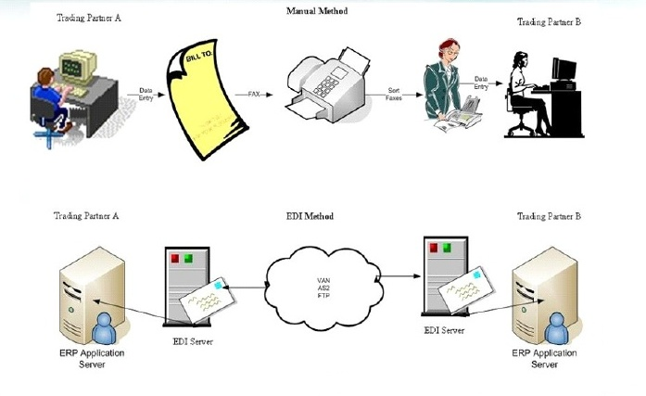
1. Electronic Data Interchange
EDI is defined as the interprocess (computer application to computer application) communication of business information in a standardized electronic form.
OR
EDI is defined as the electronic transmission of business documents in a standard format between two companies.
Notes:
A virtual area network (VAN) is a network on which users are enabled to share a more visual sense of community through high band-width connections.

Slide 3
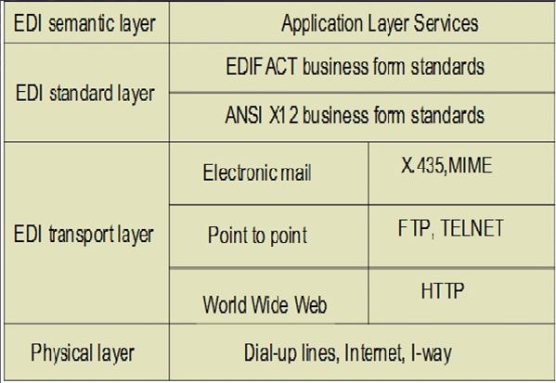
1.1 EDI layered architecture:-

Slide 4
EDI semantic layer (or Application):-
Describes the business application
Procurement example
  Requests for quotes
  Price quotes
  Purchase orders
  Acknowledgments
  Invoices
Specific to company & software used
EDI Standard Layer:
•Information seen at EDI semantic layer must be translated from a company specific form to a standard/universal form
•EDI standards layout the acceptable fields of business forms
•Two competing standards
American National Standards Institute(ANSI)X12
EDIFACT developed by UN/ECE, Working Party for the Facilitation of International Trade Procedures
Notes:
Procuring : the action of obtaining or procuring something.

Slide 5
EDI transport layer
•How the business form is sent, e.g. post, parcel, fax
•Increasingly, e-mail is the carrier
Differentiating EDI from e-mail
Emphasis on automation
EDI has certain legal status
EDI Physical layer
Dial-up lines, Internet, value-added network, etc
EDI | E-mail
No human involvement. Data is structured in a software understandable way | Human to software interface. Data are not necessarily structured
Interchange is composed/interpreted by software Reply is composed/interpreted by another software | Message is composed/interpreted by human. Reply is composed/interpreted by human

Slide 6
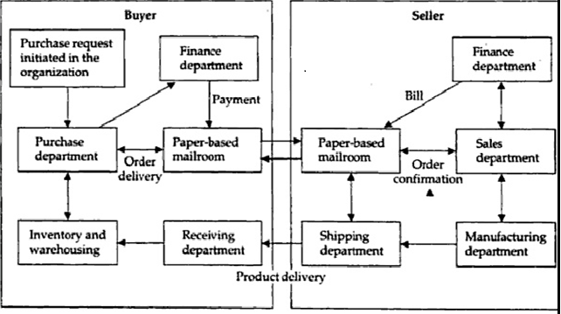
1.2 EDI in Action
The fig shows the information flow when paper documents are shuffled between organizations via the mailroom
•When the buyer sends a purchase order, then relevant data extracted & recorded on a hardcopy.
•This hard copy is forwarded to several steps, at last manually entered into system by the data entry operators
•This process is somewhat overhead in labor costs & time delays

Slide 7
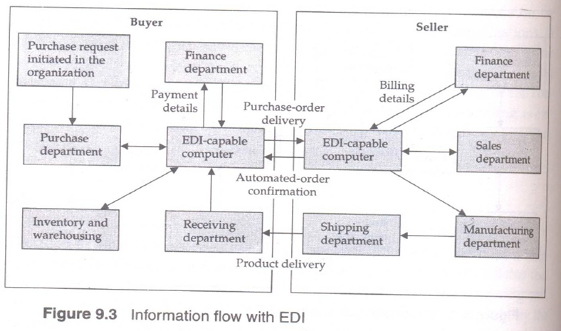

Slide 8
Information flow with EDI
1. Buyer sends purchase order to seller computer
2. Seller sends purchase order confirmation to buyer
3. Seller sends booking request to transport company
4. Transport company sends booking confirmation to seller
5. Seller sends advance ship notice to buyer
6. Transport company sends status to seller
7. Buyer sends Receipt advice to seller
8. Seller sends invoice to buyer
9. Buyer sends payment to seller EDI as a fast, inexpensive & safe method

Slide 9
1.3 Benefits of EDI
EDI can be a cost & time saving system
Reduced paper-based systems
Improved problem resolution and customer service
Expanded customer/supplier base

Slide 10
2. EDI Applications in Business
Four different scenarios in industries that use EDI extensively:
  1. International or cross-border trade
  2. Electronic funds transfer(EFT)
  3. Health care EDI for insurance claims processing
  4. Manufacturing & retail procurement

Slide 11
2.1 International or cross-border trade
• EDI has always been very closely linked with international trade.
• Trade efficiency - which allows faster, simpler, broader & less costly transactions.
2.2 Role of EDI in international trade
  • EDI facilitates the smooth flow of information
  • It reduces paper work
  • EDI benefits for international trade are
    1. Reduced transaction expenditures
    2. Quicker movement of imported & exported goods
    3. Improved customer service through “track & trace” programs
    4. Faster customs clearance & reduced opportunities for corruption, a huge problem in trade

Slide 12
2.3 The Components of International Trade
International trade is structured around thousands of freight forwarders / travel agents
  Freight forwarders act as middlemen for shippers and consumers.
Freight forwarding is a highly specialized industry in which the provider handles large freight shipments and customs clearance for customers.
Freight forwarders services
  cargo booking,
  air cargo documenting,
  consolidating cargo from numerous shippers.
The provider finds capacity for the freight on trucks, aircraft, or ocean-going vessels.
Freight forwarders usually do not own aircraft, but book space on commercial and cargo airlines on behalf of companies. The provider arranges for customs brokers to prepare import customs documentation once it arrives at its final destination.

Slide 13
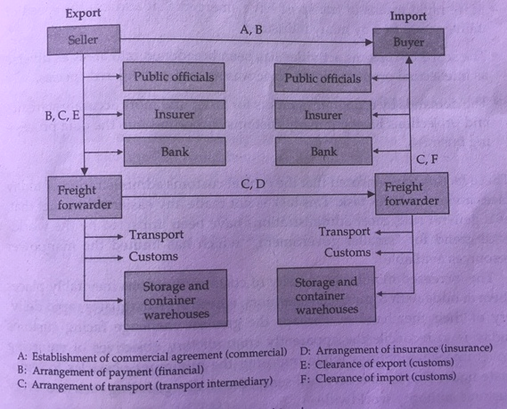
Fig : - Internals of international trade

Slide 14
These international trade agencies - shippers, airlines, forwarders, and customs in various countries - are supported by EDI and computer networks that tie them together.
EDI facilitates the transmittal of commercial documents and the associated freight information sent via modem from the foreign exporter to both the importer and his customs broker.
Important functions of international trade include banking and insurance, customs, and logistics and transport

Slide 15
2.4 Customs and International Trade
Every international trade transaction involves at least two customs clearances, export and import
Challenges : -
  Large volume of goods
  Speed of delivery
  Scope of customs activities
  Faster and more accurate statistics & projections
The increased monitoring activity of customs functions may cause a delay in rapid delivery of merchandise.
the greatest challenge is to reconcile the contradictory objectives of enforcing government regulations while imposing the minimum obstacles to legitimate trade.

Slide 16
2.5 Logistics of transport
JIT demands tight delivery windows
Global sourcing means coordinating vendors worldwide
Time critical delivery saves money : - Remote suppliers must also deliver in time
2.6 Trade Point Global Network
World wide network of trade points
Trade points – Bring togeteher all service needed by exporters (Govt,Custom,Chamber of commerce,banks ,insurers & freight forwarders)
Trade point services
  Trade facilitation center - Exporters come under one roof
  Source of trade related information
  Global networking
Notes:
Logistics : the detailed organization and implementation of a complex operation.

Slide 17
2.7 Financial EDI
Financial EDI comprises the electronic transmission of payments and remittance information between a payer, payee, and their respective banks.
Financial EDI allows businesses to replace the labor-intensive activities associated with issuing, mailing, and collecting checks through the banking system with automated initiation, transmission, and processing of payment instructions.
It eliminates the delays inherent in processing checks.
Financial EDI also improves the certainty of the payment flows between corporate bank accounts
  the payee's bank can credit its account on the scheduled payment date and the payer's bank can debit its account on the same day.

Slide 18
Types of Financial EDI
Financial EDI consists of three types of payment methods.
  Bank Checks
  Electronic Fund Transfer (EFT)
  Automated Clearing Houses (ACH)

Slide 19
1. Bank Checks
Checks are instruments for debit transfers where payees collect funds from payers. Funds made available by banks to depositors of checks are provisional and may be reversed if the payer does not have sufficient funds in its account to pay the check when it is received by the payer's bank.
Businesses use check to make payments for two main reasons
They are a familiar and readily accepted form of payment despite some uncertainty about receiving final payment.
Businesses benefit from the float created by the delays in the check-collection process. Businesses find float valuable because they can continue to use or invest funds for several days after they have issued a check.
        Float is created when a delay occurs between the initiation of a payment and the availability of the funds to the recipient.
        Delays occur because checks are delivered through the mail, require human handling, and must be transported among banks in the collection chain.

Slide 20
2. Interbank Electronic Funds Transfer (EFT)
Electronic funds transfers (EFT) are credit transfers between banks where funds flow directly from the payer's bank to the payee's bank.
        They are same-day, almost instantaneous payments.
EFT is one of the earliest examples of payment systems that use on-line transactions, although these transactions are carried out on private networks.
Funds transfers account for an extremely small portion of the total number of non cash payments.
Businesses use EFT when timeliness and certainty of payment are paramount.

Slide 21
3. Automated Clearing House (ACH) Transfers
ACH transfers are used to process high volumes of relatively small-dollar payments for settlement in one or two business days.
An ACH provides the following services:
preauthorized credits – direct deposit of payrolls
preauthorized debits – repetitive bill payment
Consumer initiated payment – High volume/Low dollar consumer oriented product

Slide 22
Two types of ACH transfers are used:
  Credit transfers + large-dollar funds transfers in that funds flow directly from the payer's bank to the payee's.
  Debit transfers - the payee's bank initiates the transfer and receives funds immediately from the payer's
Uses of ACH:
Businesses typically use ACH credit transfers to pay for goods or services and to make tax payments to state and local governments.
ACH debit transfers are used less often than credit transfers for business-to-business payments.

Slide 23
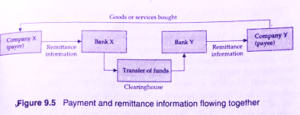
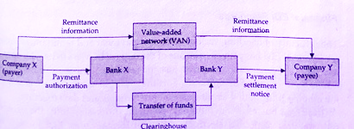
\
Financial EDI payments
Payment and remittance information flowing together
Payment information flowing through banking system, remittance information are transmitted over direct data communication link or VAN

Slide 24
2.8 Health Care and Insurance
EDI is rapidly becoming a permanent fixture in both insurance and health care industries as medial providers, patients, and payers increasingly process claims via electronic networks.
Electronic claim processing is quick and reduces the administrative costs of health care.
In most cases, claims can be sent to payers within 24 hours. Fewer errors translates to decreased turnaround time.
EDI enables doctors to communicate with other physicians, laboratories, hospitals, and other health care settings.
In short, it leads to better managed care.

Slide 25
Comparison of EDI and paper based claims
  Using EDI software, service providers prepare the forms & submit claims via communication lines to the value-added network service provider
  The company then edits sorts & distributes forms to the payer. If necessary, the insurance company can electronically route transactions to a third-party for price evaluation
  Claims submission also receives reports regarding claim status & request for additional information
Advantages of using EDI are :
Payer receives claims in standard format
Processing takes only 3-4 days
Administrative cost reduction

Slide 26
2.9 Manufacturing/Retail Procurement Using EDI
In manufacturing, EDI is used to support just-in-time.
In retailing. EDI is used to support quick response.

Slide 27
Just-In-Time & EDI
•Companies using JIT & EDI calculates how many parts are needed each day based on the production schedule & electronically transmit orders.
•Delivery has to be responsive, or it will cost too much in money & time.
•Getting data to suppliers quickly
•A major benefit of JIT & EDI is a streamlined cash flow
    When a company receives an invoice, it pays for parts that are actually in use, in a product ready to be sold, instead of paying for large, costly items stored in inventory.
Quick Response & EDI
•For the customer, QR means better service & availability of a wider range of products
•For the retailer & supplier, QR may mean survival in a competitive marketplace
•Much focus of QR is in reduction of lead times using event-driven EDI.
•In QR, EDI documents include purchase orders, shipping notices, invoices, inventory position, catalogs, & order status

Slide 28
2.10 Business Information, Product design and Procurement
Business Information – All information required by enterprises for palnning ,execution & monitoring of product manufacturing and marketing

Slide 29
3. EDI: Legal, Security and Privacy Issues
In EDI, we are dealing with trade between countries and corporations, issues of legal admissibility and computer security are paramount.
  Companies that deal with EDI often retain the services of a lawyer during the design of an EDI application so that the appropriate evidentiary/admissibility safeguards are implemented.
Legal Status of EDI Messages
No rules exist that indicate how electronic messages may be considered binding in business or other related transactions.
Messaging systems combine features of both instantaneous & delayed communications
A message's delay is a function of the specific application, message routing, network(s) traversed, system configuration, and other technical factors typically unknown to the user.

Slide 30
Digital Signatures and EDI
Time-stamped or establish date and times at which recipient might have claim to have access
If digital signatures are to replace handwritten signatures, they must have the same legal status as handwritten signatures.

Slide 31
4. EDI Standards
The exchange of business documents in a commonly agreed structured format necessitated the development of EDI standards.
The two major EDI standards are :
American National Standards Institute (ANSI) X. 12 Committee and
United Nations EDI for Administration, Commerce, and Trade (EDIFACT) standards for international usage.

Slide 32
ANSI X.12
The ANSI chartered the Accredited Standards Committee in 1979 to research and develop standards for business documents.
The X.12 committee develops standards to facilitate EDI relating to such business transactions as
  order placement and processing;
  shipping and receiving;
  Invoicing, payment,and cash application processing for products and services.
Each transaction format includes many data segments needed for the business function as well as instructive information to ensure that the telecommunication system routes the data correctly.
      Eg:- Vendor registration (Form no: 838)
      X.12 transactions are transmitted through e-mail or MIME

Slide 33
EDIFACT
Developed by the United Nations, EDIFACT is a family of standards similar to ANSI X.12.
EDIFACT was based on TRADECOMS, developed by the U.K. Department of Customs and Excise with the assistance of SITPRO (the British Simplification of Trade Procedures Board).

Slide 34
Structure of EDI Transactions
EDI standards are very broad and general because they have to meet the needs of all business.
EDI messages, however, share a common structure :
Transaction set is equivalent to a business document, such as a purchase order. Each transaction set is made up of data segments.
Data segments are logical groups of data elements that together convey information, such as invoice terms, shipping information, or purchase order line.
Data elements are individual fields, such as purchase order number, quantity on order, unit price.

Slide 35
Comparison of EDIFACT and ANSI X.12 Standards
Segments – Strings of data elements
Transaction set/message – Set of segments ordered by as specified by a standard
ANSI | EDIFACT
Each element to have a very specific name, such as order date or invoice date. | EDIFACT segments, allow for generic, or multiuse elements, such as date. A qualifier, such as order or invoice, accompanies the generic elements identifying what the date relates to
ANSI has more segments | EDIFACT has fewer segments and only one beginning segment(Header),but it has more composites
Not much versions | Different versions available

Slide 36
5. EDI envelope for message transport
To differentiate EDI from regular mail message headers or envelopes has been devised.
2 types of envelopes are used
X.435 (derived from ISO X.400 mail std.,used in VAN)
Internet EDI based on MIME (based on RFC 822)

Slide 37
x.400 & x.435 Envelopes
X.400 is an open standard for mail exchange
It was meant to solve problems like binary file transfer and to produce single , consistent addressing scheme
X.400 exist in 3 versions
1984 version – defines basic system for storing and forwarding messages
1988 version – provide enhanced services like security and remote message storage
1992 version – message type expanded with store and forward services
2 methods based on header information have been developed to carry EDI traffic on X.400 network.
Header is placed at top of message and act as address on outside of an envelope. Network act as post office and moves data between computers

Slide 38
First method wraps X.400 header around EDI header and EDI data. This is called double bagging.
It is a simple method for carrying EDI message over X.400 network, but it causes duplication of information in EDI and X400 headers
Second method called X435 insert special field in X400 envelope to identify EDI message.
X435 specifies how EDI content is distinguished with an X400 message.
X435 eliminates duplication and has the ability to handle multiple body parts.(purchase order +drawing sheets)
Other features are data integrity, encryption, notification of message delivery, non repudiation
X435 is a reliable and scalable to send EDI and accompanying files.

Slide 39
MIME-Based EDI
MIME dictates how multimedia message attachments such as spreadsheets, word processing documents, or EDI transaction sets can be sent as enveloped messages using the Internet Simple Mail Transport Protocol (SMTP).
SMTP provides a common specification for the exchange of e-mail messages between systems and networks.
SMTP defines how messages are addressed and their format as well.
No authentication, confidentiality, or data integrity properties are provided in SMTP or MIME.

Slide 40
Multipurpose Internet Mail Extensions (MIME)
Multimedia is rapidly becoming part and parcel of network applications - in electronic mail, EDI, World Wide Web
MIME, a specification that offers a way to interchange text in languages with different character sets and multimedia e-mail among many different computer systems.
MIME allows users to create and read e-mail messages containing the following :
  Character sets other than ASCII
  Enriched text with special symbols such as a mathematics
  Graphics images
  Audio files or sounds
  Binary files-PostScript and compressed files such as tar or zip files
  Other not-yet-invented data or information types'.
MIME supports several predefined types of non textual message contents, also permits users to define their own types of message parts easily. This flexibility is essential for communicating EDI-related information where the information content may not fit. exactly what the standard specifies.

Slide 41
The MIME specification defines four different header fields :
A MIME-version header labels a message as MIME-conformant. This header allows different MIME-aware mail user agents to process the message appropriately.
A content-type header field specifies the data types within the message. Within the content-type header various fields are used to describe different message types and subtypes. So far, there is a text type, a multipart type (for multiple parts in a single message), an application type (for data shared between applications, such as a spreadsheet), a message type (for encapsulated messages), an image type, an audio type, and a video type.
A. content-transfer-encoding header field specifies the concluding used to get the message through a given message transport system, such as the Internet.
Two optional header fields, a content-ID and a content-description header server to label and identify the data in the message.

Slide 42
MIME User Agent (UA)
The MIME standard describes how mail user agents identify different message types, so that the user's mail interface can properly display the data for the user.
A MIME UA can handle complex multipart messages regardless of the mail transport agent; computer operating systems, or network operating system.
the MIME UA has a MIME parser and a dispatcher.
To display a multipart / multimedia message, the MIME UA first passes the message through a purser, which identifies the different components of the message from the header information.
The UA's dispatcher then accesses a specific viewer for each message type, specifying output as a graphic, text, PostScript, and so forth.
MIME-compatible applications can be extended easily.

Slide 43
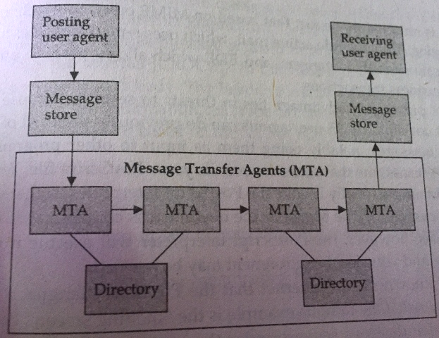
Computing components of mail Handling systems
Any mail system has four major components :
user agents,
message store,
message transfer agent (MTA), and
directory services
(Refer fig. 10.3)

Slide 44
The user agent creates, responds to, and receives mail
the message store, queues up undelivered messages and receives mail even when mail clients are off-line. Private user mailboxes are part of the message store. A collection of user mailboxes on the same server and the queue of messages waiting to be delivered on that server are called a post office. EDI applications may either use their own mailboxes or share the mailboxes of other applications or users.
the message transfer agent (MTA), sorts and routes messages among mailboxes and post offices. The MTA uses a mail protocol that defines the format of the message's envelope, address, contents, and attachments. Simple Mail Transfer Protocol (SMTP) for UNIX systems, and X.400 In the case of EDI, MIME will serve as the Internet standard.
EDI service directories will become essential for looking up mail addresses.

Slide 45
MIME Advantages and Disadvantages
MIME is the perfect vehicle to ship binary files around the Internet.
The strength of MIME comes from its careful design to survive the different variations of mail transport protocols
MIME's primary disadvantages lies in threats to security because of the user agent concept.

Slide 46
6. Internet based EDI
Internet can be used directly for exchanging EDI messages. Several factors make Internet useful for EDI
Flat pricing
Cheap access
Common mail standard
Security

Slide 47
E mail based Messaging
It is the simplest and widely used method
IETF –MIME encapsulation specification is used to enclose EDI data within e mail message (IETF - Internet Engineering Task Force)
TP(trading partner) agree on encryption method (PGP/PEM)
TP then exchange
  E mail address for EDI message and e mail address for personal communication related to EDI
  Agreement on DS and encryption protocol, e mail acknowledgment
  Public key for PEM or PGP
  Agreement on format (X12 ,EDIFACT)

Slide 48
FTP based messaging
To exchange EDI message via FTP, some set up information must be included in TP agreement.
Each TP will create an account for FTP log in including password
TP agreement include
  FTP log in name ,password, machine from which log in accepted
  Directory or file naming conventions
  File encryption protocols and keys
  Wrapper(headers ) around EDI data
  Agreement on format (X12 ,EDIFACT)

Slide 49
EDI Gateways
Gateways are built to act as communication hubs between different sections of same organization or outside TP.
Gateways are necessary when using multiple standards.
Common gateway facilities include
  EDI message construction and translation
  Translation between application software package standards and in house standard
  Translation between in house standard and EDI format
  Transmission between internal data communication standard and those of recipient
  Queue management
  Compliance checking for ensuring correctness
  Session management and directory services
  Security and management features
  Call logging facilities
  Creation of TP relationships and establishment of TP profiles
  Additional services like interactive database queries

